Slide 1
AJAX, JSON – Rich Internet Applications with XML and JSON

Slide 2
AJAX
Asynchronous Javascript and XML
AJAX is not a programming language.
Rather AJAX is a techniques used by web developers in order to make website behave like desktop applications.
HTML & CSS ==== Client side
Javascript == client side program validation
XML, JSON=== structure the data
Php== server side programming

Slide 3
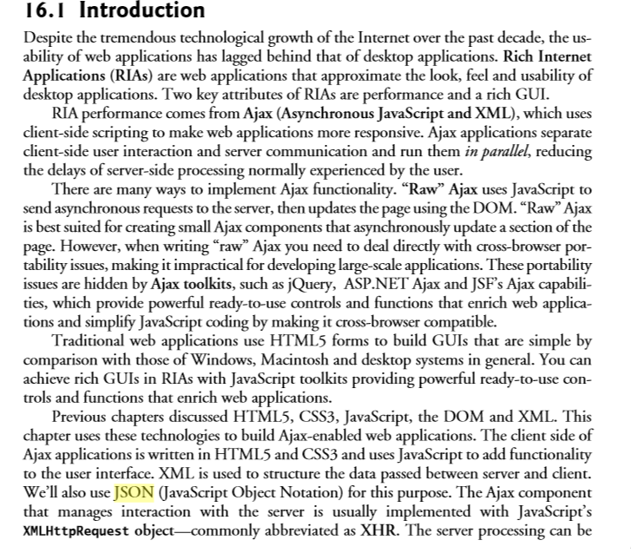

Slide 4
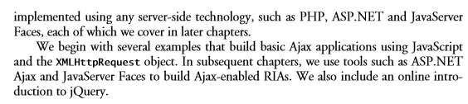

Slide 5
AJAX
Asynchronous means that we are exchanging data to /from the server in the back ground without having to refresh the page.
Client –Server side application ---
based on request and response call.

Slide 6
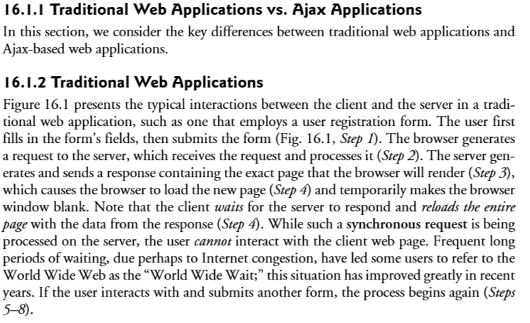

Slide 7
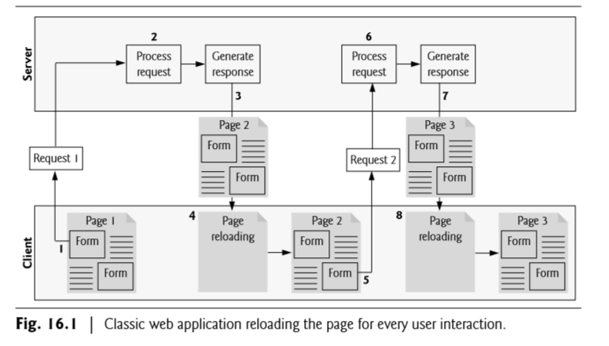

Slide 8
Response in AJAX Application
Using AJAX multiple requests are happening concurrently in the same time or client doesn’t have to wait for a response from a server in order to make a new request
Responses from the server in AJAX are handled in the form of callback
A callback is special function which is used in AJAX, so that server can respond to the client when it is ready to send data to the client

Slide 9
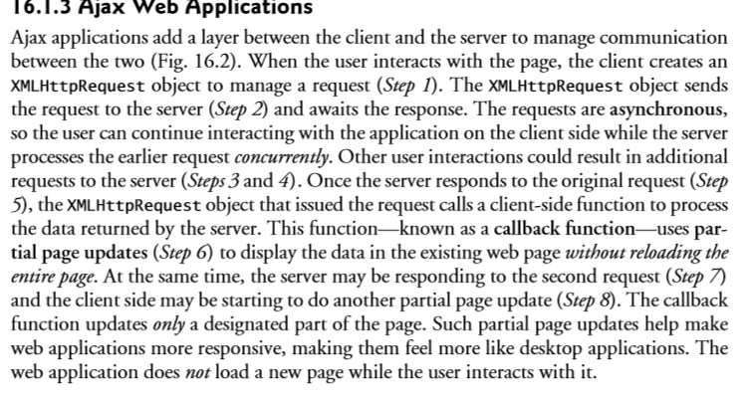

Slide 10
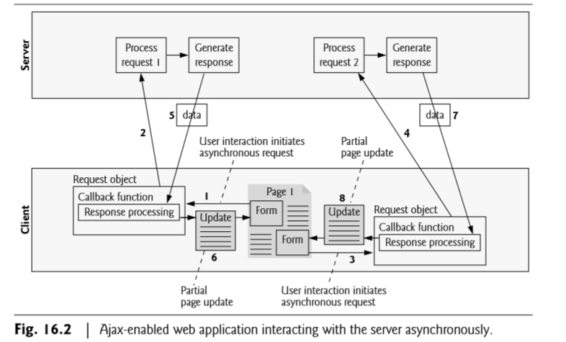

Slide 11
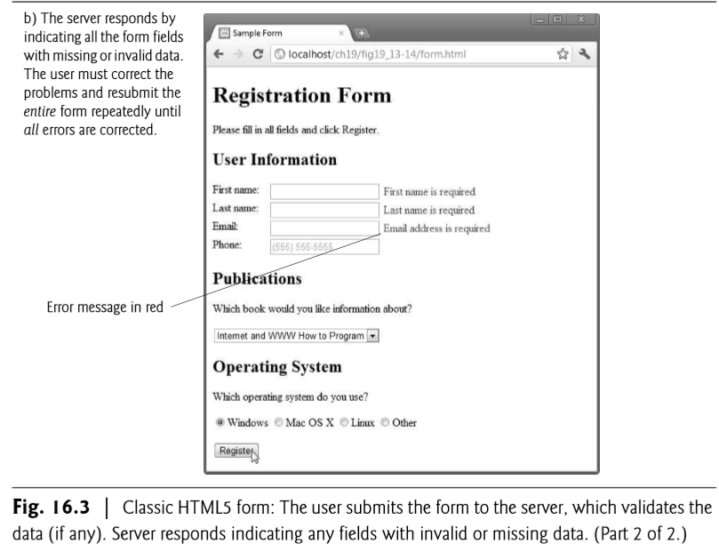

Slide 12
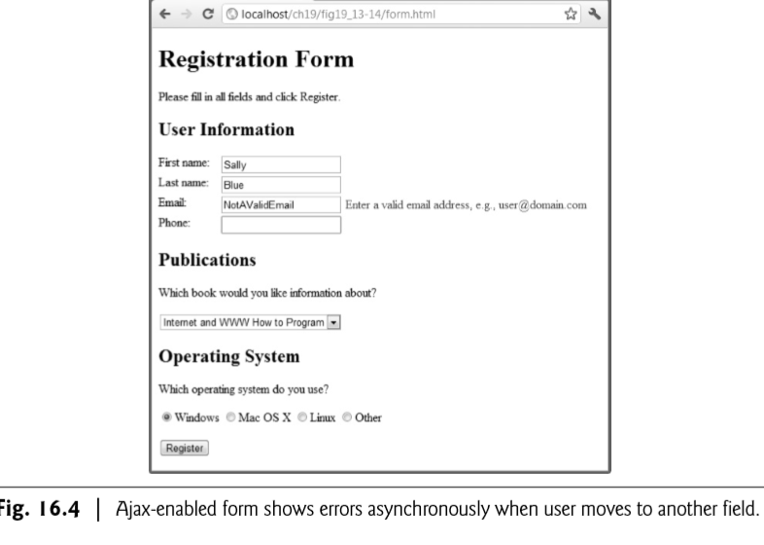

Slide 13
Implement AJAX into Application
Create an XMLHTTPREQUEST object.
All modern browsers support the XMLHTTPREQUEST object.
The XMLHTTPREQUEST object can be used to exchange data with a server behind the scenes.
This means that it is possible to update parts of a web page, without reloading the whole webpage.

Slide 14
Implement AJAX into Application
Syntax for creating XMLHTTPREQUEST object
Var Variable-name=new XMLHttpRequest();
Var xhr= new XMLHttpRequest();
Step2
Making a request to the server the XMLHttpRequest object is usedto exchange data with a server.

Slide 15
Implement AJAX into Application
To send a request to a server we use the open() and send()methods of the XMLHttpRequest object.
Xhr.open(‘get’, ‘url’, true);
STEP3
Handling the response coming from the server the onreadyStatechange property
It holds the states of the XMLHttpRequest.
It defines a function to be executed when the ready state changes.

Slide 16
Implement AJAX into Application
Ready state : holds the status of XMLHttpRequest
0: request not initialized
1: server connection established
2: request received
3: processing request
4: request finished and response ready.
Status:
200 “ok”
403 “forbidden”
404 “page not found”

Slide 17
Implement AJAX into Application
Xhr.onreadystatechange=function(){
If(this.readyState==4 && this.status==200){
Document.getElementById(“demo”).innerHTML=this.responseText;
} };
Executing this anynomous functions when this readystatechage event trigger or readystate is 4 and status is 200 .
Modifying the inner html if id demo with the responsethat is returned from the server.

Slide 18
Implement AJAX into Application
Step4
Send the request to server
Xhr.send();

Slide 19
Implement AJAX into Application
Var xhr= new XMLHttpRequest(); ➔ 1
Xhr.onreadystatechange=function(){
If(this.readyState==4 && this.status==200){
Document.getElementById(“demo”).innerHTML=this.responseText;
} }; ➔2
xhr.open(“GET”, “URL”, TRUE); ➔3
Xhr.send(); ➔ 4

Slide 20
JSON
Java Script Object Notation
[
{
“ename” : “jhon”,
“eid” : 123,
“edes” : “Manager”
},
{
“ename” : “aaa”,
“eid” : 124,
“edes” : “clerk”
},
{
“ename” : “bbb”,
“eid” : 125,
“edes” : “developer”
}
]

Slide 21
Create an HTML5 document
Add jQuery library
Add the div to update
Create the script that will update the content
Test by uploading updated text to a web server

